Slide 1
An Economic Study of Global Water
Preliminary Analysis of Alternative Scenarios with CLIMAWAT 101, a CGE World Model of Climate, Water and Trade

Slide 2
Water as a Global Commons and Public Good
Water is a critical natural resource, vital for life and ecosystems.
Some of its special challenges to economic analysis:
1. Its nature as a renewable resource which is both a global commons and a public good.
2. Non-excludability and growing rivalry in water usage.
3. Finite availability , unequal distribution, sustainable management.

Slide 3
Water in Economic Modelling: Special Challenges
Representing water's multiple roles: as a consumption and production good, a natural resource, and an output.
Accounting for the value of water across different economic sectors and agents.
Water's interconnectedness over space and time.
Difficulties in reflecting the externality effects and opportunity costs of water use in models.
Impact of water use in one sector on other sectors due to shared resources.
Trans-boundary water issues and the need for cooperative management.
The long-term implications of water conservation and production on economic stability.
Modeling the ripple effects of water-related decisions on global trade and economics.

Slide 4
Comprehensive Analysis Program
Objectives and Methodology
Understanding Water's Dual Nature: Examining water as both a shared resource of the planet and a global public good.
Assessing Water Balance Discrepancies: Estimating water imbalances, identifying the regions and communities at greatest risk of water deficit.
Data-Centric Approach for Prioritization: Utilizing available data to compile a comprehensive database on water use, availability, accessibility, infrastructure, and the socio-economic indicators pertinent to the global economy.
Economic Analysis through CGE Modelling: Developing a computable general equilibrium model for the international economy to evaluate the repercussions of inaction using hypothetical scenarios and policy interventions.
2. Data Sources
Water Resources:
Availability and Usage: Data from the Food and Agriculture Organization (FAO- Aquastat and related data bases)
Consumption Patterns: Data from the Water Footprint Network
Economic Water Indicators: Information from the World Bank water database and the European Data Portal
Global Economy:
Socio-Economic Information: The Global Trade Analysis Project (GTAP) Database
Technical and Financial Parameters: Sourced from World Bank, FAO, scholarly research, other CGE models, and econometric studies.
World input output Database

Slide 5
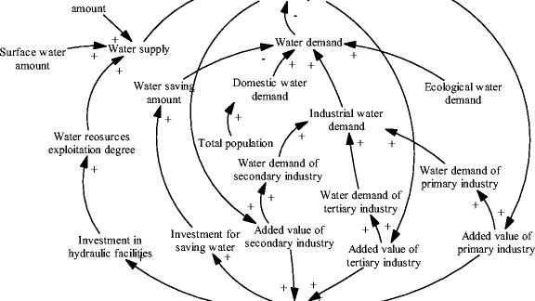
Developing CLIMAWAT : a Global SAM - CGE Model for Water
Purpose: To analyze the economic impact of water resources on global economies (the “cost of inaction”) using a computable general equilibrium approach.
Scope: To capture essential features of the world economy and relevant interactions between water supply and demand across different sectors and regions of the world economy.
Structure: Incorporates economic activities, consumption patterns, production technologies, and trade relationships.
Main goal: Exploring the economic implications of water scarcity, climate change, and policy interventions on water use.

Slide 6
Some Preliminary Results
From CLIMAWAT: a World Extended-SAM and CGE

Slide 7
Total Water Use (TWU) based on Social Accounting Matrix (SAM) Estimates
TWU world SAM estimates account for direct and indirect water uses from intermediate goods as well as from final consumption (from households, government and other institutions).
The SAM estimates presented assume that household and government consumption are endogenous and only capital formation is determined independently as a consequence of autonomous, forward-looking decisions.
Therefore, the SAM estimates compute the amount of direct and indirect uses of water along the value chains (backward linkages) and the final consumption (forward linkages) generated by yearly exogenous capital formation.
SAM data: GTAP Database 11; data from 2017, 9 Macroregions plus Rest of the World, 12 commodities per region, 12 activities per region, 3 institutions per region (Households, Government, Capital Formation), taxes, tariffs and international trade.

Slide 8
The blue-water green-water paradigm
Rainfall, the undifferentiated freshwater resource, is partitioned in a green-water resource as moisture in the unsaturated zone and in a blue-water resource in aquifers, lakes, wetlands, and impoundments (e.g., dams).
These resources generate flows, as green-water flow from terrestrial biomass producing systems (crops, forests, grasslands, and savannas) and blue-water flow in rivers, through wetlands, and through base flow from groundwater.
(M. Falkenmark and J. Rockström , The new Blue and Green Water Paradigm: Breaking New Ground for Water Resources Planning and Management, Journal of Water Resources and Planning, 2006)

Slide 9
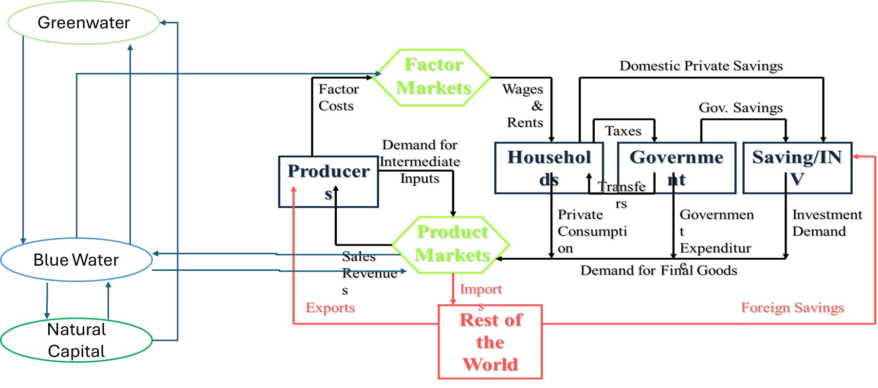
Blue and Green Water in the SAM
Rainfall, the undifferentiated freshwater resource, is partitioned in a green-water resource as moisture in the unsaturated zone and in a blue-water resource in aquifers, lakes, wetlands, and impoundments (e.g., dams).
Greenwater: Enters the Economy with Rain and feeds the agriculture sector and the blue water as recharge.
Blue Water: Uses greenwater as input of production of agriculture and other economic sectors. It increases the productivity of the activities.
Activities: Use Greenwater and Blue water, increase their productivity and pay back to blue water a part of their use. For the part used and not paid for a contingent debt is generated with natural capital, which receives also the part of evapotranspiration.
Natural Capital Formation: Includes recharge and evapotranspiration

Slide 10
CLIMAWAT CGE Calibration
Selected Estimates and Experiments

Slide 11
Overview of a Global CGE Model for Water
Purpose: To analyze the economic impact of water resources on global economies (the “cost of inaction”) using a computable general equilibrium approach.
Scope: To capture essential features of the world economy and relevant interactions between water supply and demand across different sectors and regions of the world economy.
Structure: Incorporates economic activities, consumption patterns, production technologies, and trade relationships.
Main goal: Exploring the economic implications of water scarcity, climate change, and policy interventions on water use.

Slide 12
Technical Aspects of CGE Water Model
Data Integration: Uses data from main statistical sources (e.g., FAO, Water Footprint Network), biophysical models, economic databases, econometric estimates and climate change projections.
Sectoral Detail: Includes detailed representation of water-intensive sectors like agriculture, energy, and manufacturing for 165 countries.
Behavioral Assumptions: Assumes bounded rationality, i.e., profit-maximizing producers and utility-maximizing consumers subject to resource and institutional constraints.
Market Equilibrium: Determines both market and nonmarket (shadow) water prices based on the balance of supply and demand, taking into account water trading and transportation costs.

Slide 13
Some Results of Model Experiments
Comparative Static Experiments:
Comparative static experiments involve comparing two or more static scenarios to understand the impact of changes between them. In this context, BAU scenarios are compared with alternative scenarios that incorporate climate change and policy interventions.
Business as Usual (BAU) Scenarios:
BAU scenarios assume no significant changes in current trends or policies. They serve as a baseline to evaluate the effects of alternative interventions.
Alternative Simulations:
Alternative simulations include different climate change projections and policy scenarios. These are used to explore the potential impacts of climate change and the effectiveness of various policy measures.
Model Solutions Projected to 2050:
The model's projections extend to the year 2050. This long-term horizon allows for the assessment of sustained impacts over time, considering how policies and climate change might evolve.
Dynamic Steady States:
The hypothesis that these solutions may represent dynamic steady states means that the model assumes the economy reaches a new equilibrium by 2050 under each scenario. This helps in understanding the long-term equilibrium effects of different policies and climate impacts.
Integrating Impacts on Growth and Levels:
By integrating impacts on growth with impacts on levels, the approach captures both how fast economies grow and the absolute changes in economic levels (such as GDP or resource stocks). This dual focus provides a more complete picture of the consequences of climate change and policy actions.

Slide 14
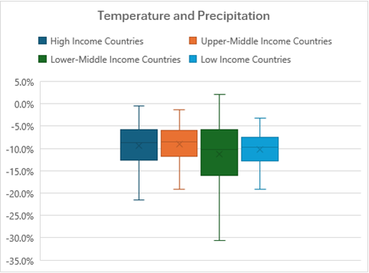
Main Model Estimates: Impact of Climate Change on GDP (projections to 2050)

Slide 15
Main Model Estimates: Impact of Climate Change and Trends in Water Storage (TWS) on GDP (projections to 2050)
This chart illustrates the impact of changes in temperature, precipitation, and trends in satellite measures of total water storage (TWS) across countries categorized by income level. The results are represented as percentage changes, highlighting the varying degrees of impact on high-income, upper-middle-income, lower-middle-income, and low-income countries.
The findings suggest that while all income groups are negatively impacted by changes in temperature, precipitation, and TWS, the degree and variability of the impact differ significantly. High-income countries appear to be slightly less affected compared to lower-income groups, which might indicate higher reliance on agriculture of this last group, and varying levels of resilience and adaptation capacity to climate-related changes.

Slide 16
Virtual Water Trade Estimates (2050)
Analysis of Per Capita Virtual Water Net Imports by Country Income Group: Comparing Baseline, Business-As-Usual, and Climate Change Scenarios.
The chart highlights significant disparities in virtual water trade among different income groups, particularly under climate change conditions, suggesting vulnerability and adaptation challenges for lower income countries.

Slide 17
Estimates of Virtual Water Export Shares (Model Projections to 2050)
This bar chart illustrates the shares of virtual water exports across different country income groups in the base year, under business-as-usual (BAU) conditions, and projected climate change scenarios.
The chart shows that high-income countries dominate virtual water exports in all scenarios, though their share decreases slightly under climate change conditions. Upper-middle-income countries exhibit a stable export share across all scenarios, indicating resilience in their water-exporting sectors.
Lower-middle-income and low-income countries show minimal participation in virtual water exports, with a slight increase under climate change, suggesting potential shifts in water resource utilization and economic impacts.
This data highlights the disparities in virtual water trade and suggests that climate change could redistribute water-related economic advantages among different income groups.

Slide 18
Estimates of Virtual Water Import Shares (Model Projections to 2050)
This bar chart displays the proportions of virtual water imports for high income, upper-middle income, lower-middle income, and low-income countries during the base year, under business-as-usual (BAU) conditions, and within a climate change scenario.
The chart indicates that high-income countries are the largest importers of virtual water, but their share decreases in both the BAU and slightly less in the climate change scenario.
Upper-middle income countries increase their share under climate change, possibly due to shifts in global agricultural patterns or economic changes that increase dependence on imported water-intensive goods.
Lower-middle income and low-income countries maintain relatively low and stable import shares across all scenarios, reflecting their limited economic flexibility to increase imports.

Slide 19
Estimated Impact on Virtual Trade (2050)
This diagram shows the differences in per capita net virtual imports of blue water from a BAU scenario across different income groups.
High-income countries (presently net exporters) show a substantial increase suggesting reducing exports and increased imports of virtual water goods.
Upper-middle, lower-middle, and low-income countries (presently net importers) experience declines in net virtual imports.

Slide 20
Estimated Impact on Blue Water Virtual Trade (2050)
This graph illustrates the percentage change in blue water net (virtual) imports under climate change compared to the BAU scenario.
The results indicates that higher-income countries are likely to reduce their net imports of blue water (mainly expanding their exports), likely reflecting improvements in water efficiency and self-sufficiency.
In contrast, low-income countries are becoming more dependent on imports, highlighting the need for targeted support to enhance water resource management and resilience in these regions.

Slide 21
Estimated Impact on Green Water Virtual Trade (2050)
This graph illustrates the percentage change in green water net imports across different country groups under climate change compared to the BAU scenario.
The results indicate that countries across all income groups are decreasing their net imports of green water, except for lower middle-income countries, which show a moderate increase.

Slide 22
Estimated Impact on Total Water Virtual Trade (2050)
This diagram illustrates the percentage changes in total net virtual water imports from BAU due to climate changes across different country groups. High and upper middle-income countries both experience moderate reductions, with high-income countries seeing the most substantial decrease.
Low-income countries show a more pronounced decline, mostly due to green water, while lower-middle-income countries display a wider range of potential negative outcomes.
This suggests that climate change impacts vary significantly across different economic groups, with lower middle-income countries potentially facing the greatest challenges in managing water resources.

Slide 23
Policy Experiments: Internalizing the Externalities through Efficiency Pricing (2050)
This chart shows the impact of various levels of water pricing on GDP across the different income and regional country groups, set against a baseline that includes the impacts of climate change and TWS variations.
The diagram shows GDP impacts at different incremental water pricing levels (7%, 15%, 22%, 30%) with each subsequent percentage representing an increased level of water pricing, proportional to shadow price levels and intended to reflect a progressively stricter water resource management or conservation policy.

Slide 24
Policy Experiments: Internalizing the Externalities through Efficiency Pricing (2050)
The figure demonstrates the effect of implementing a policy package aimed at improving water efficiency and reducing resource misallocation on GDP across different country groups by approximately 20%.
The results show a significant positive impact on lower-middle-income countries and low-income countries, with GDP increases of approximately 15% and 8%, respectively. High-income and upper-middle-income countries experience negligible changes.
By effectively addressing externalities through targeted policies, countries can achieve higher efficiency and better resource management, particularly benefiting those with more water-intensive economies.

Slide 25
Sector Impact of Water Efficiency Pricing (2050)

Slide 26
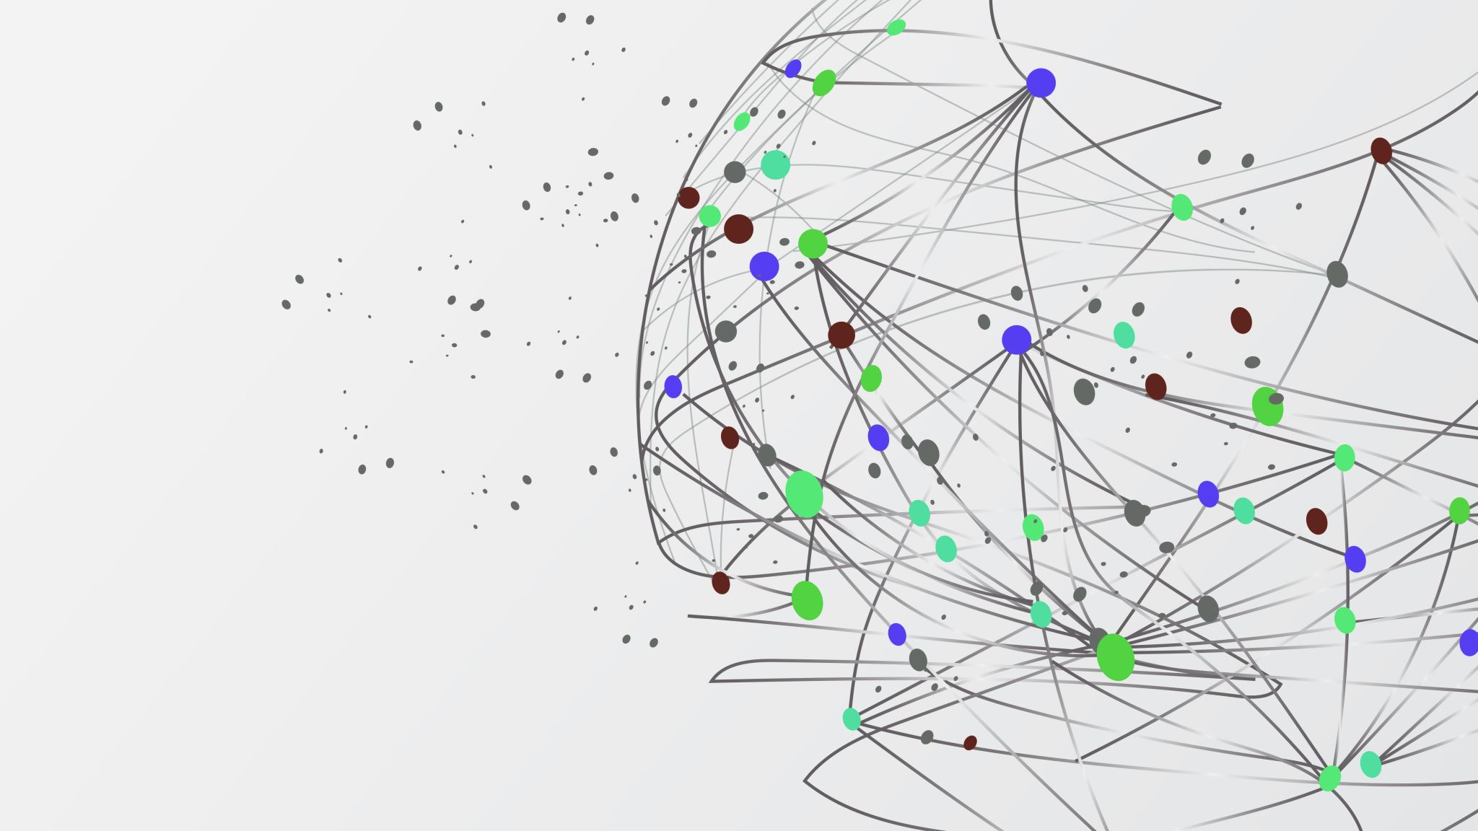
Thanks for your attention!

