Slide 1
Developing CLIMAWAT 101: A Global CGE Model
Key features of water as a public good and a global commons

Slide 2
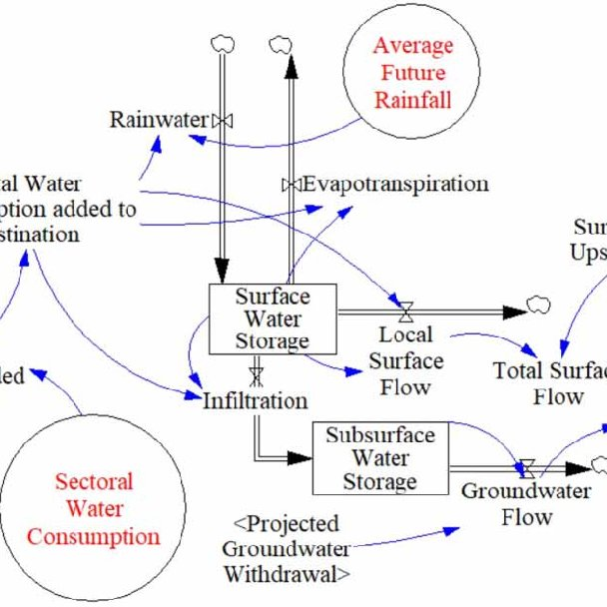
The Water Cycle
The water cycle shows the continuous movement of water within the Earth and atmosphere. It is a complex system that includes many different processes. Liquid water evaporates into water vapor, condenses to form clouds, and precipitates back to earth in the form of rain and snow. Water in different phases moves through the atmosphere (transportation). Liquid water flows across land (runoff), into the ground (infiltration and percolation), and through the ground (groundwater). Groundwater moves into plants (plant uptake) and evaporates from plants into the atmosphere (transpiration). Solid ice and snow can turn directly into gas (sublimation). The opposite can also take place when water vapor becomes solid (deposition).

Slide 3
The water cycle equations
Process | Equation | Definition and Meaning | Symbol Definitions
Evaporation (E) | E = (K_e × (e_s - e_a)) | Process by which water changes from liquid to gas. Rate of evaporation depends on factors like temperature, humidity, and wind speed. | E: Evaporation rate, K_e: Evaporation coefficient, e_s: Saturation vapor pressure at surface, e_a: Actual vapor pressure
Transpiration (T) | Similar to E, often combined as ET | Process of water movement through a plant and its evaporation from aerial parts, like leaves. Critical in plant-water relations. | T: Transpiration rate (often combined with E in evapotranspiration, ET)
Precipitation (P) | P = Depth × Area | Water released from clouds as rain, snow, sleet, or hail. It's a major component of the water cycle, replenishing water in the system. | P: Precipitation, Depth: Depth of water (e.g., rainfall), Area: Area over which precipitation is measured
Infiltration (I) | I = K × A × (dh/dl) | Process where water on the ground surface enters the soil. Influenced by soil properties, land cover, and precipitation intensity. | I: Infiltration rate, K: Hydraulic conductivity, A: Area, dh/dl: Hydraulic gradient
Runoff (R) | R = P - (E + T + I) | Water flow that occurs when soil is infiltrated to full capacity and excess water from rain, meltwater, or other sources flows over the land. | R: Runoff, P: Precipitation, E: Evaporation, T: Transpiration, I: Infiltration

Slide 4
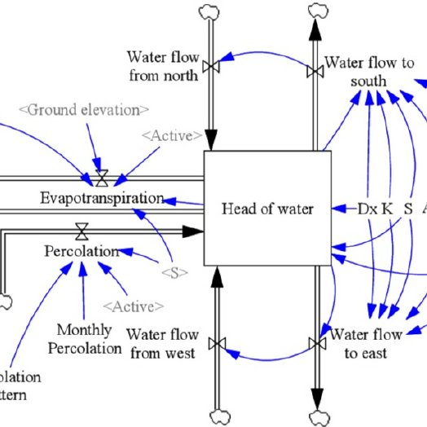
The Aerial Model
Atmospheric moisture generated by forests not only affects water availability in the local catchment, it is also transported into other regions or even continents by prevailing winds. This phenomenon of air currents bringing water vapour generated by forests into different regions is known as “flying rivers”.

Slide 5
The equations for «flying rivers»
Process | Equation | Definition and Meaning | Symbol Definitions
Evapotranspiration (ET) | ET = E + T | Combined process of evaporation and transpiration, where water is transferred from the land to the atmosphere. | ET: Total evapotranspiration, E: Evaporation, T: Transpiration
Water Vapor Transport | ∂ρv/∂t + ∇⋅(ρv→v) = Sv | Movement of atmospheric moisture by wind, described by the continuity equation, accounting for the density and velocity of water vapor. | ρv: Water vapor density, →v: Wind velocity vector, Sv: Source/sink terms due to evaporation or precipitation
Precipitation (P) | P = f(ρv, temperature, atmospheric pressure, etc.) | The process by which water vapor condenses and falls as rain, snow, or other forms of moisture, dependent on atmospheric conditions. | P: Precipitation, ρv: Water vapor density, f: Function of various atmospheric conditions

Slide 6
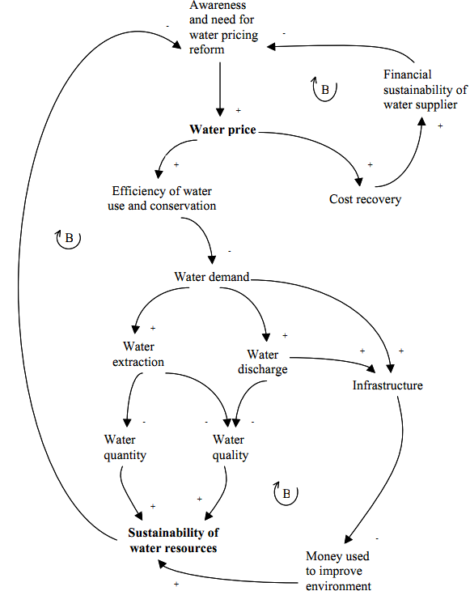
Demand and Supply of Water
The Earth's diverse climate cycles result in an uneven global distribution of water resources, with access further influenced by economic disparities. Average water consumption per person varies dramatically: 137 liters globally, rising to 250-300 liters in Europe and 600 liters in North America and Japan, but dropping to 10-20 liters in Sub-Saharan Africa. Challenges such as population growth, changing consumption patterns, intensive agriculture, and environmental pollution, along with climate change impacting rainfall, exacerbate pressures on both water quantity and quality. Over the last century, worldwide water use has increased sixfold and continues to grow, potentially leading to a 40% global water deficit by 2030, as reported by the 2030 Water Resources Group and UNESCO.

Slide 7
Basic Equations for Water Demand and Supply
Component | Equation | Explanation | Symbol Definitions
Demand for Water (D) | D = f(P, I, Pop, F) | The demand for water depends on its price, income levels, population, and other factors. Prices are water tariffs for registered water and rents (price signals) for unregistered water. | D: Demand, P: Price of water, I: Income level, Pop: Population, F: Other factors
Supply of Water (S) | S = g(P, C) | The supply of water is related to its price and the costs of production. | S: Supply, P: Price of water, C: Costs of production
Equilibrium (market) | D = S | Equilibrium is where the quantity of water demanded equals the quantity supplied. | D: Demand, S: Supply
Equilibrium (social): Marginal Social Benefit = Marginal Social Cost | MSB = MSC | Optimal allocation of water occurs where the marginal social benefit equals the marginal social cost. | MSB: Marginal Social Benefit, MSC: Marginal Social Cost
Externalities in Social Cost | MSC = MPC + E | Social cost includes the private cost of production and externalities. | MSC: Marginal Social Cost, MPC: Marginal Private Cost, E: Externalities

Slide 8
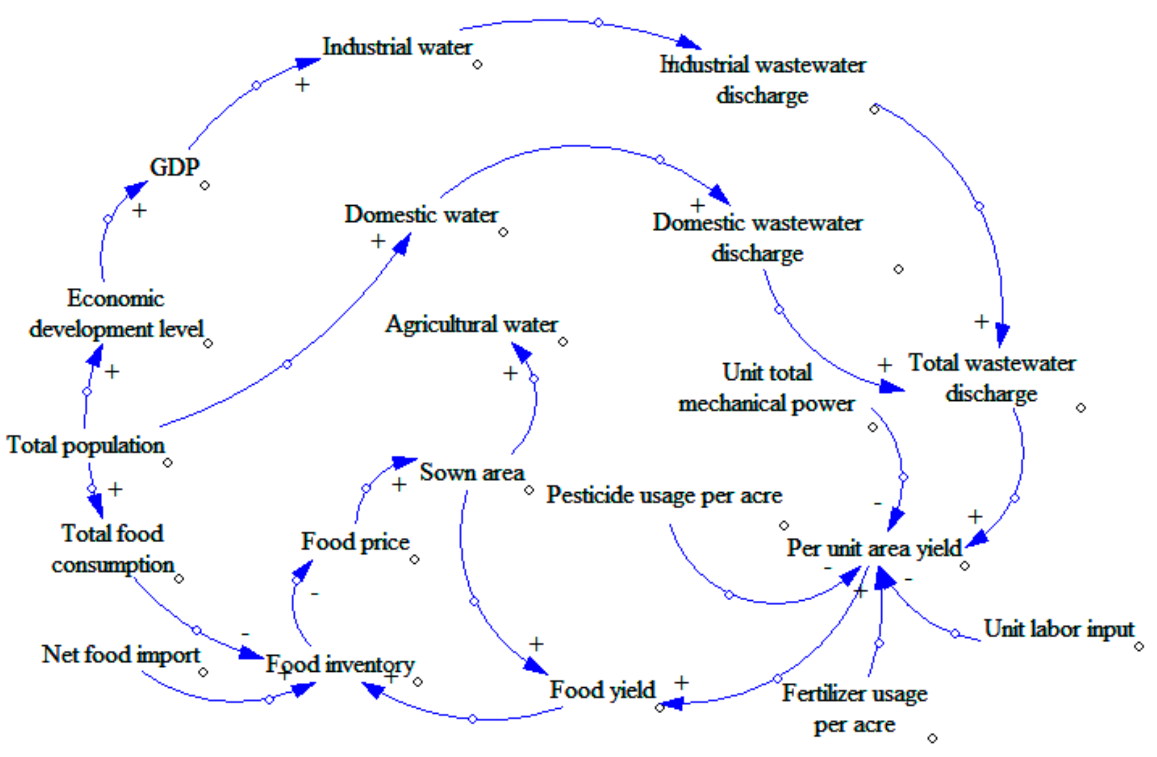
The Economic Water Cycle
Of the 3% of freshwater that is part of the large water cycle on our planet, only ¼ is accessible in water tables and surface water (run-off, rivers, lakes). In addition to the unequal distribution of water resources over the continents and countries, in different climates and stages of development, there are new pressures in the modern world: demographic growth and climate change. Problems involving water resource quantity and quality mean that water resource management must be adapted.

Slide 9
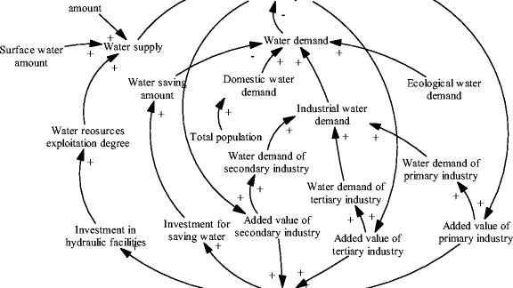
Sustainable water management means changing from a linear economy (extraction, manufacturing, consumption, disposal) to a circular, or “3R”, economy (Reduce, Re-use, Recycle).
One of the European Union’s priorities is to improve wastewater treatment before disposal. Water cycle management is becoming more complicated, with increased amounts of wastewater, the risk of saturating sanitation systems and treatment facilities, and the fact that the appearance of emerging pollutants (pesticides, medical residue, micro-plastics) in wastewater and rainwater means new treatment procedures are required.

Slide 10
Basic Equations for a Circular Economy
Component | Equation | Explanation | Symbol Definitions
Demand for Water (D) | D = f(P, I, Pop, F) | The demand for water depends on its price, income levels, population, and other factors. | D: Demand, P: Price of water, I: Income level, Pop: Population, F: Other factors
Supply of Water (S) | S = g(P, C) | The supply of water is related to its price and the costs of production. | S: Supply, P: Price of water, C: Costs of production
Equilibrium | D = S | Equilibrium is where the quantity of water demanded equals the quantity supplied. | D: Demand, S: Supply
Marginal Social Benefit = Marginal Social Cost | MSB = MSC | Optimal allocation of water occurs where the marginal social benefit equals the marginal social cost. | MSB: Marginal Social Benefit, MSC: Marginal Social Cost
Externalities in Social Cost | MSC = MPC + E | Social cost includes the private cost of production and externalities. | MSC: Marginal Social Cost, MPC: Marginal Private Cost, E: Externalities

Slide 12
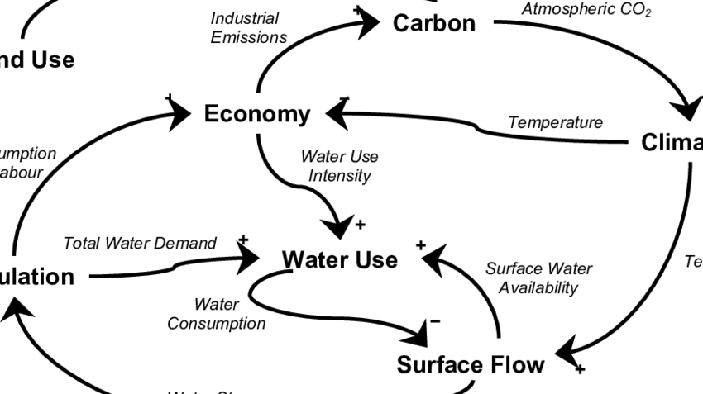
Human activities like land reclamation, drainage of wetlands, deforestation, and soil sealing are constantly diminishing the resource efficiency of ecosystems. These actions lead to land conversion and water diversion for human use, thereby lowering the ecosystem's stage of succession. As a result, the ecosystem's capacity to retain water, perform evapotranspiration, and achieve its primary production potential is compromised. Consequently, the water cycling ability of the landscape is diminished under these altered conditions.

Slide 13
The Equations for the Global Water Footprint
Component | Equation | Explanation | Symbol Definitions
Blue Water Footprint (WF_blue) | WF_blue = Σ (V_i × C_i) | The volume of surface and groundwater used in the production process. | WF_blue: Blue Water Footprint, V_i: Volume of freshwater used, C_i: Crop/product yield per unit of water
Green Water Footprint (WF_green) | WF_green = Σ (P_i - ET_i) | The volume of rainwater consumed during the production process. | WF_green: Green Water Footprint, P_i: Precipitation on the crop field, ET_i: Evapotranspiration of the crop
Grey Water Footprint (WF_grey) | WF_grey = Σ (L_i × (C_s,i - C_nat,i) / C_max,i) | The volume of freshwater needed to dilute pollutants to meet specific water quality standards. | WF_grey: Grey Water Footprint, L_i: Pollutant load, C_s,i: Concentration of pollutant in wastewater,

